Slide 1
Small Network ZERONX
MD. ISTIUK AHMED MITUL
5 May,2025
Course Title : Networking Fundamentals

Slide 2
Company Overview
Company Name: Zeronx
Type of Business:
Zeronx is a small technology consulting firm specializing in IT solutions for local businesses, including network installation, troubleshooting, and managed services,
Employees:
6 full-time staff members including consultants, support technicians, and administrative personnel.
Business Needs:
A secure and reliable internal LAN to support daily operations
Centralized server for web hosting and internal services (DNS, DHCP)
External access to the company website from clients and prospects via the internet
Scalable network infrastructure for future growth

Slide 3
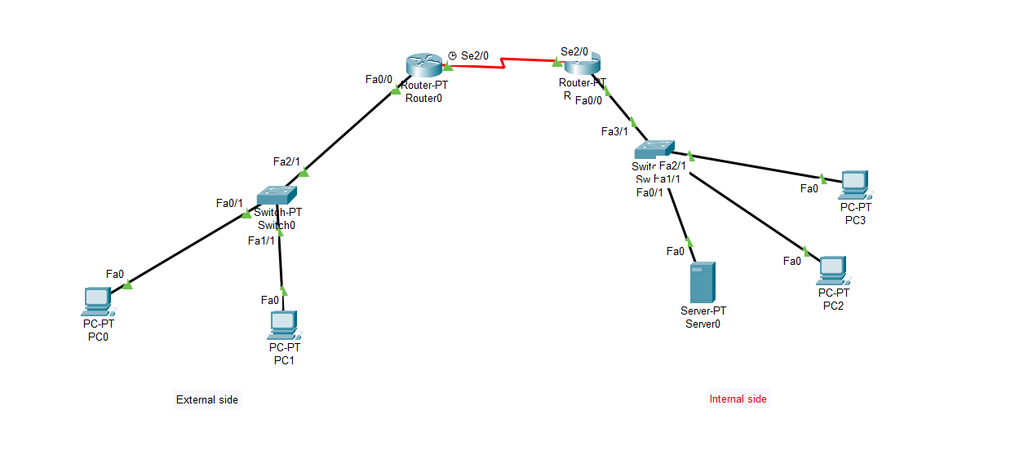
Network Design Overview
conponents :
2 routers (internal and edge)
2 switches (LAN segments)
4 PCs (employees)
1 Web/DNS Server
1 External client for testing

Slide 4
Internal Network Setup
Devices: PC0–PC3, Server
Services: DHCP, DNS, HTTP
Addressing: Private IP range (10.10.10.x)
LAN Segments: Split by switch/router

Slide 5
Web Server & Public Access
Web Server Role: Hosts http://www.company.com
DNS Config: Resolves domain to server IP
External Access: External PC can access via public IP and DNS

Slide 6
Internet & NAT Configuration
Router with NAT: Translates private to public IP
Outside Client: Pings and browses internal web server

Slide 7
Services in the Network
DHCP: Auto IP assignment
DNS: Domain resolution
NAT: Internet access for internal users

Slide 8
Justification of Design Choices
Wired LAN: Reliable and secure
Two routers: Separation of LAN and WAN
Central server: Combines DNS + Web hosting
Future scalability supported

Slide 9
Summary
Internal communication working (PCs pingable)
DNS resolves www.company.com
Web server accessible internally and externally

